Slide 1

Welcome to Year 6 2024-2025

Slide 2
What we want for the children:
A new start every day
An environment of shared respect
A desire to achieve and do their best – encouraged by high expectations and challenge
A love of learning fostered by knowing that their best is all that matters
A happy year which leaves fond memories.

Slide 3
What are we offering?
Commitment and respect for your children as individuals
Building on previous years’ progress
A secure environment where your children are free to ask the questions they want answered
Quality lessons carefully planned, delivered and assessed
Extra support where required

Slide 4
What do we expect?
Good routines in order to maximise learning time. A commitment to doing their best and achieving potential in all work
A reflective approach to learning – become life long learners
Homework done on time and to the best of their best ability – let us know if your child is taking longer than 15 minutes on each subject or if there has been a problem completing it
Increased independence in their learning in preparation for KS3 – although we supply all the equipment they need, they need to be responsible for it at all times!

Slide 5
The School Week:
Daily English and Whole Class Guided reading lessons.
Daily maths lessons.
Daily story times.
1 Science session per week.
1 Topic session per week.
P.E. on a Wednesday
Computing, French, Music, Art, RE and PSHE lessons too.

Slide 6
What else can we look forward to?
Brenscombe trip – soon!
Swimming
Salisbury Cathedral leavers service
Chalke Valley History Festival
Transition sessions with new school in the summer term
Water load of fun

Slide 7
Homework
The expectation is for homework to be done outside of school time. Homework is written in diaries and listed on the class blog as well.
Homework will consist of 3 x 10 minute tests in Maths, Reading, Spelling punctuation and grammar.
We expect homework to be handed in on Monday. If your child is stuck on their homework please can they let us know before it is due to give us the chance to help!
If homework is not handed in, an opportunity will be given during Monday breaktime.
Notes:
This is all to ensure they are more prepared for secondary school and are responsible for their own homework.
If your child has done their homework but forgotten it, we will ask them to redo it at lunchtime on a Monday. This is to make them responsible not only for doing it, but for

Slide 8
Reading, spelling and times tables
In order to make expected progress, reading at home should be for 15 minutes out loud to an adult, at least 3 times per week and initialled in the diary by an adult.
Spellings – Practise these 3 times per week, either with an adult or go on Spelling Shed. There is a link to Spelling Shed on the Y6 homepage. Spellings are set on a Monday, copied into the diaries and tested the following Monday.
Times tables – Go on TT Rockstars. Aim to go on at least twice a week. Try to make sure that at least one session is on Studio.
Notes:
We ask children to read aloud, because then the adult can ask questions, check vocabulary understanding and inference.

Slide 9
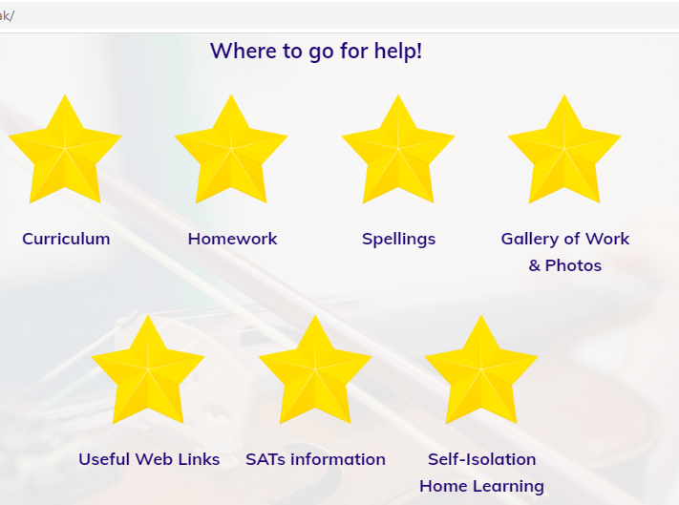
Our Class Page help section
Notes:
Parents can see the homework on our webpage plus links to helpful sites.

Slide 10
How Can You Help?
Make sure homework is completed and diaries signed
Keep reading with your children (and initial the reading record). Ask them questions and explain words to them, so their vocabulary grows.
Make sure the children arrive on time
Keep talking to us about how things are going.
Send in healthy snacks, fruit or veg, for break.
Join Friends of School or be a volunteer reader.

Slide 11
If you have any concerns during the school year:
Please, please talk to us – we all want the same thing: the very best education for your children.
Use the homework diary as a means of communication
Make an appointment to meet with us
Pastoral issues – we are here to help!

